Slide 1
MCA MINI PROJECT — INTERIM PROGRESS PRESENTATION
ClauseIQ
Machine Learning-Based Contract Clause Classification and Intelligent Search System
Empirical Model Evaluation, Architectural Selection, and Pipeline Verification
PRESENTED BY:
MOHAMMED FARHAN K
Register No: MAC25MCA-2042
Master of Computer Applications (MCA)
Department of Computer Applications
PROJECT GUIDANCE & INSTITUTION:
Dr. SONIA ABRAHAM
Associate Professor, Dept. of Computer Applications
Mar Athanasius College of Engineering (MACE)
Kothamangalam, Kerala — September 2026
Notes:
Good morning respected evaluators and guide.
I am Mohammed Farhan K, Register Number MAC25MCA-2042, presenting the Interim Project Presentation for my MCA mini project: 'ClauseIQ – Machine Learning-Based Contract Clause Classification and Intelligent Search System'.
In our first presentation, we laid out the architectural plan and initial dataset profiling. Today, for this interim milestone, I am presenting the verified empirical results of our end-to-end machine learning pipeline, including four trained and hyperparameter-tuned classification models, comprehensive metric evaluations on our held-out test set, production model selection, error analysis via confusion matrix, and our intelligent search prototype.

Slide 2
CONTEXT & MOTIVATION
PROBLEM STATEMENT & MOTIVATION
Operational Bottlenecks in Commercial Contract Review & The Need for Classical ML
1. Manual Review Bottleneck
• Massive Contract Volumes:
Enterprise commercial agreements routinely span 30–100+ dense legal pages.
• Cognitive Fatigue & Errors:
Manual legal review suffers severe human fatigue, creating major risk of overlooking critical clauses.
• High Legal Costs:
Due diligence and contract compliance costs are prohibitively high for small-to-midsize legal teams.
2. Limitations of Keyword Search
• Literal Keyword Mismatch:
Standard regex and Ctrl+F tools fail when drafting conventions use synonyms (e.g., 'cap on liability' vs 'aggregate exposure').
• Lack of Legal Concept Awareness:
Keyword search cannot group clauses by legal functionality.
• Time-Consuming Triage:
Attorneys spend up to 60% of review time merely locating clauses rather than analyzing liability.
3. Why Classical ML Over LLMs?
• Zero Cloud API Latency:
Processes clauses in sub-10 milliseconds without network overhead or token costs.
• Data Privacy & Sovereignty:
Client contracts never leave the secure local environment (critical for legal confidentiality).
• Zero Hallucination Risk:
Deterministic classification and vector retrieval guarantee 100% factual clause extraction without generative fabrications.
ClauseIQ — ML-Based Contract Clause Classification and Intelligent Search
Dept. of Computer Applications, MACE | Slide 2
Notes:
In this slide, I briefly revisit the project motivation while bridging directly to our implementation choices.
Legal contract review is bottlenecked by manual review fatigue across dozens of pages, and standard keyword searches fail because legal drafting varies wildly across jurisdictions.
Importantly, we chose a classical machine learning pipeline with TF-IDF vectorization rather than a heavy LLM. In an enterprise legal workflow, contracts are highly confidential, cloud LLM APIs introduce latency and data privacy risks, and generative models can hallucinate. Classical ML provides deterministic classification, sub-10 millisecond retrieval speeds, and complete data privacy locally.

Slide 3
OBJECTIVES & SCOPE
PROJECT OBJECTIVES & CURRENT SCOPE
Deliverables Planned vs. Actually Completed at the Interim Milestone
Core Project Deliverables
• Automated Multi-Class Classification: Categorize extracted contract clauses into 41 distinct legal categories with calibrated confidence scores.
• Intelligent Semantic Retrieval Engine: Enable conceptual search across 12,204 clauses using TF-IDF and cosine similarity without requiring exact keyword matches.
• Lightweight RESTful API Backend: Serve inference and search via FastAPI with Pydantic validation, CORS middleware, and lifespan resource management.
• Interactive Web Dashboard: Provide an attorney-facing web interface for contract upload, automated clause extraction, and visual risk inspection.
Interim Milestone: What is Completed?
✔ Data Pipeline & Validation: 12,204 clauses cleaned, verified 0 nulls, 41 categories mapped.
✔ Feature Engineering: 10,000-dimensional TF-IDF vector space fitted strictly on train split.
✔ 4 Candidate Models Trained & Tuned: Logistic Regression, Linear SVM, Multinomial Naive Bayes, and Random Forest.
✔ Comprehensive Multi-Metric Evaluation: Accuracy, Macro/Weighted Precision, Recall, and F1 benchmarks.
✔ Model Selection & Error Analysis: Selected Logistic Regression based on primary Macro-F1 metric; generated 41x41 confusion matrices.
✔ Search Engine & FastAPI Prototype: Completed in-memory search prototype (P@1=80.0%, P@5=88.0%) and FastAPI endpoints with 15/15 passing tests.
ClauseIQ — ML-Based Contract Clause Classification and Intelligent Search
Dept. of Computer Applications, MACE | Slide 3
Notes:
On Slide 3, we establish the boundary of this interim presentation.
Our overall project targets four key deliverables: 41-class classification, semantic search, a FastAPI backend, and a web interface.
For this interim milestone, we have completed the core machine learning lifecycle: the dataset curation, the text preprocessing pipeline, 10,000-dimensional TF-IDF feature extraction, training and tuning all four candidate classifiers, evaluating them on the exact same held-out test set, selecting Logistic Regression as our production model, and creating the search prototype and FastAPI serving endpoints with an automated test suite. The UI and database integration are in progress for the final phase.

Slide 4
DATASET ARCHITECTURE
DATASET SPECIFICATIONS
CUAD-Derived Legal Contract Clause Corpus
510
Commercial Contracts
12,204
Labeled Clause Records
41
Legal Clause Categories
100%
Data Integrity (0 Nulls)
Dataset Source & Schema Design
• Provenance:
Derived from the Contract Understanding Atticus Dataset (CUAD v1), curated by The Atticus Project and annotated by legal experts.
• Schema Attributes (3 Core Columns):
1. contract_id: Unique string identifier linking clause to source contract.
2. clause_text: Raw textual content of the extracted clause provision.
3. category: Target ground-truth legal label (1 of 41 distinct classes).
• Document Types:
Commercial agreements, NDAs, Master Service Agreements (MSAs), Software Licenses, and Joint Ventures.
Data Integrity & Validation Metrics
• Zero Missing Values:
Validation confirms exactly 0 null entries across all 12,204 rows.
• Zero Empty Strings:
Every record contains meaningful clause text (mean: 23.93 words, median: 19 words, standard deviation: 17.88 words).
• Zero Duplicate Records:
Redundant exact row duplicates purged during raw ingestion.
• UTF-8 Sanitization:
Enforced strict Unicode normalization to remove corrupted PDF extraction artifacts and unprintable byte sequences.
ClauseIQ — ML-Based Contract Clause Classification and Intelligent Search
Dept. of Computer Applications, MACE | Slide 4
Notes:
Slide 4 presents our verified dataset specifications.
The dataset is derived from CUAD v1, containing 510 contracts and exactly 12,204 labeled clause records across 41 legal categories.
The schema has three columns: contract_id, clause_text, and category.
Through our automated data cleaning scripts in src/clean_dataset.py, we verified 100% data integrity: zero missing values, zero empty strings, and zero exact duplicates. The average clause length is 24 words, representing concise, high-density legal provisions.

Slide 5
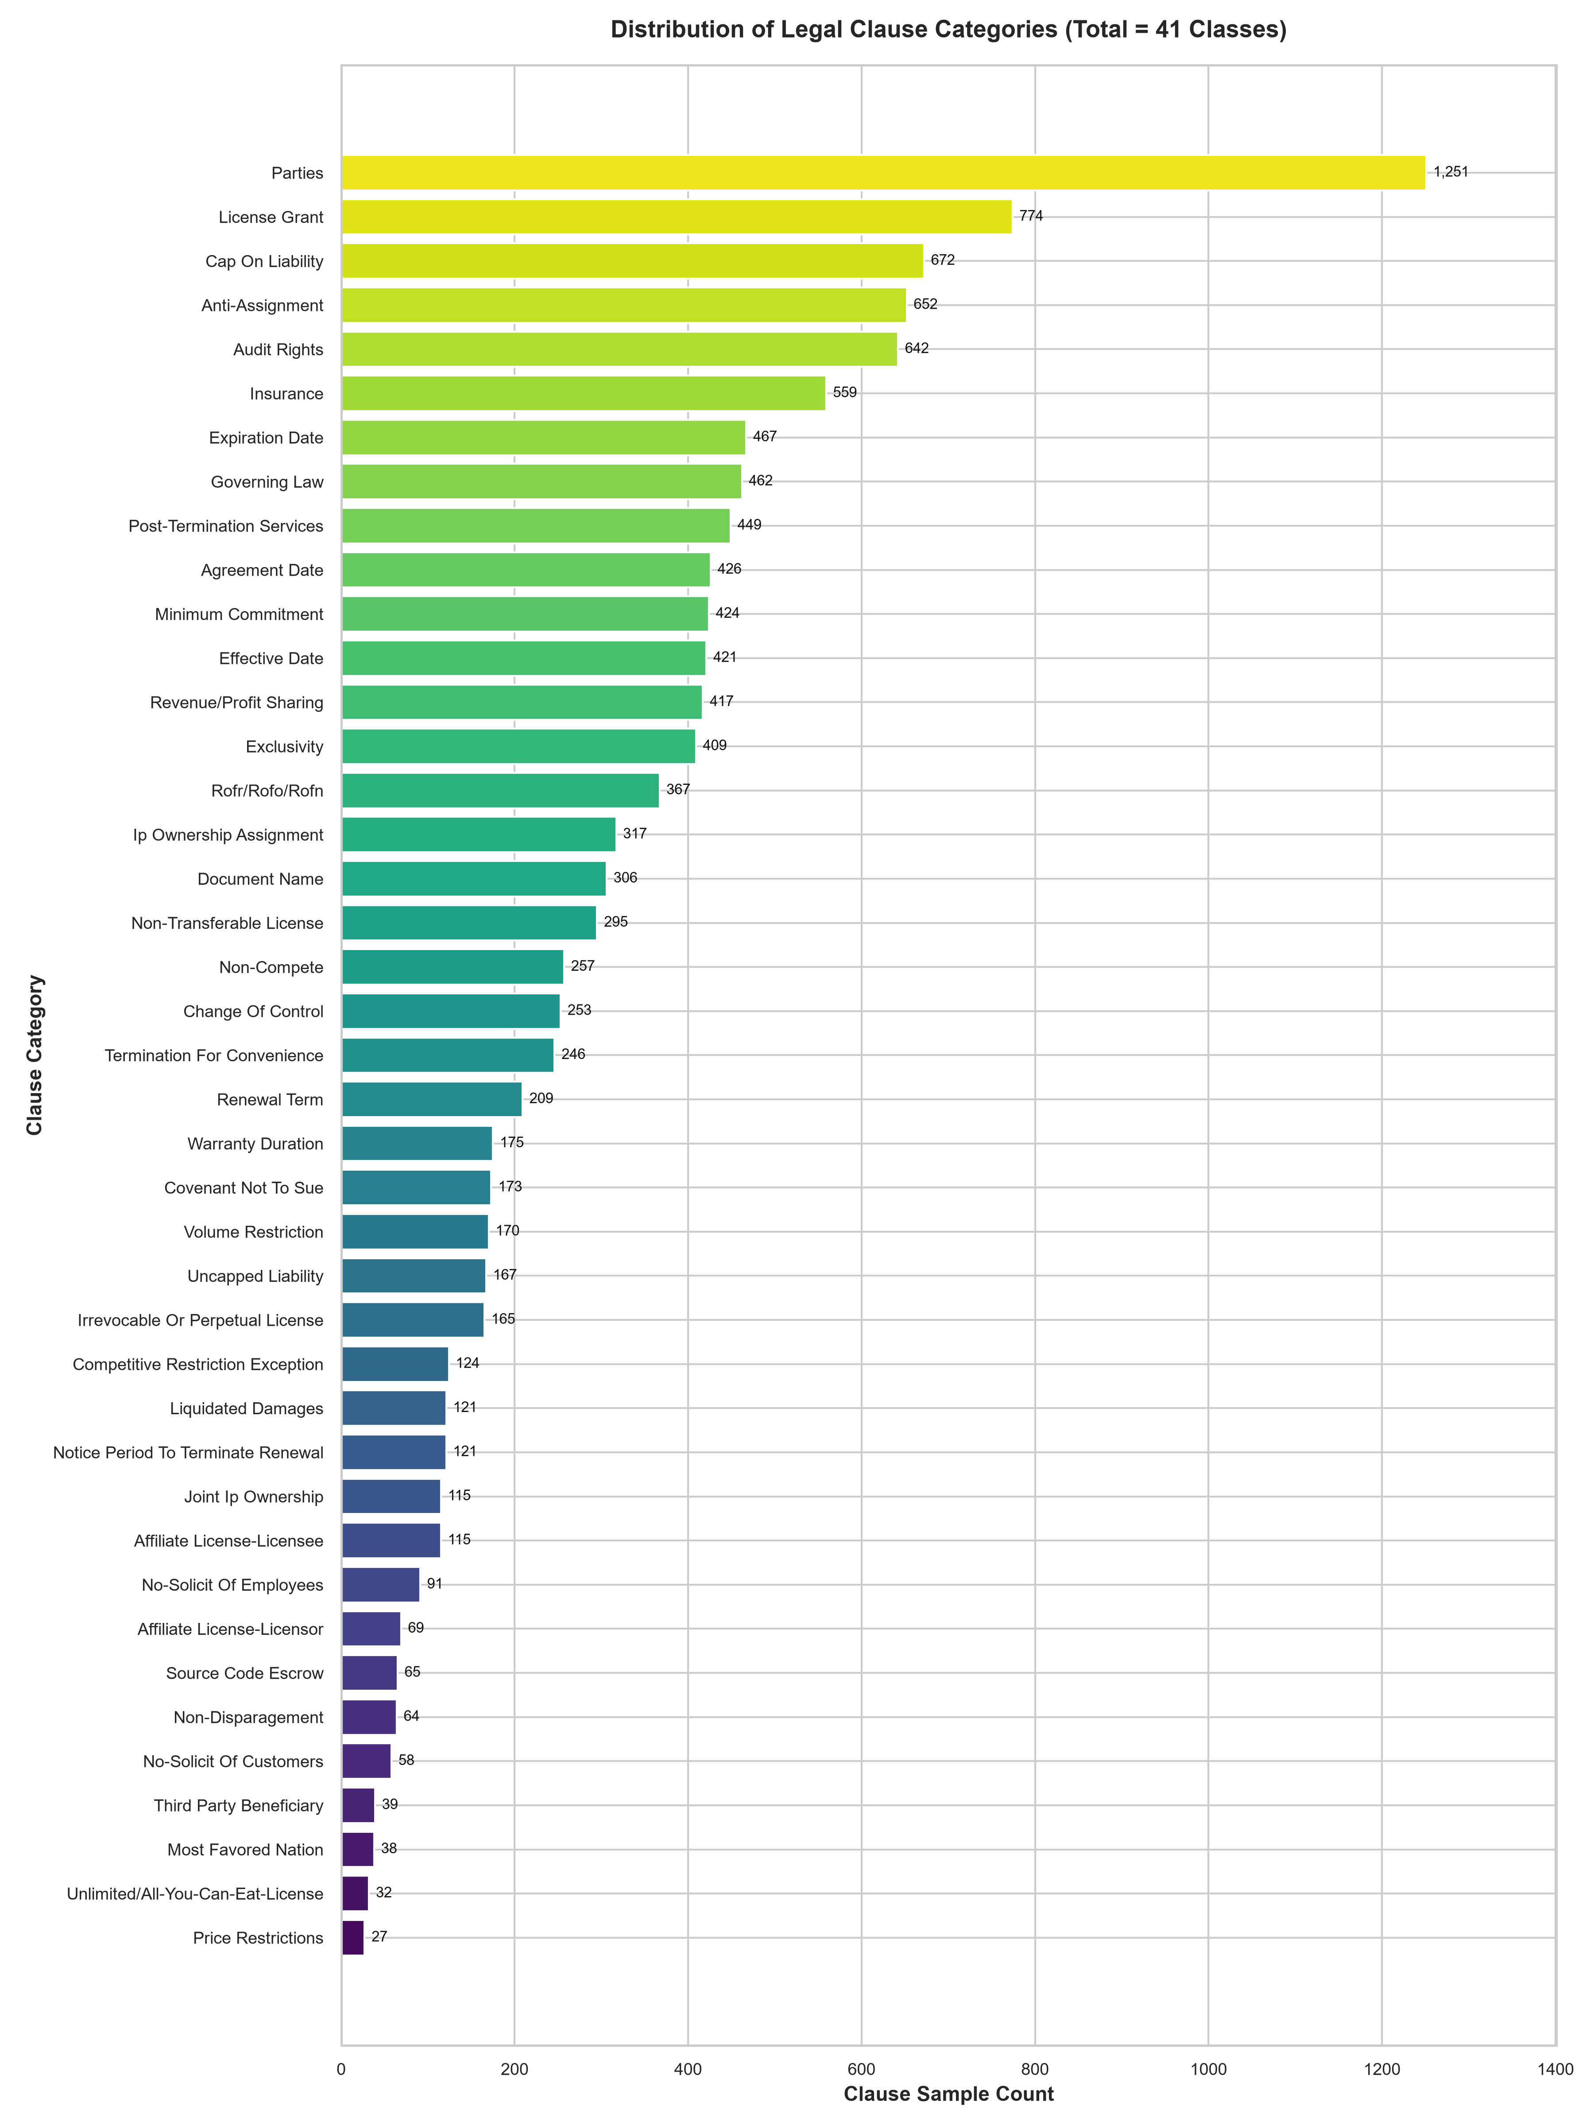
DATA PROFILING
EXPLORATORY DATA ANALYSIS & CLASS IMBALANCE
Quantifying Corpus Distribution: Severe 46.33 : 1 Imbalance Ratio
Class Distribution & Extremes
• Severe Imbalance Ratio: 46.33 : 1
The frequency ratio between the most and least represented legal categories is over 46 to 1.
• Largest Category — Parties:
1,251 instances (10.25% of corpus). Frequent boilerplate identifying contracting entities.
• Smallest Category — Price Restrictions:
Only 27 instances (0.22% of corpus). Highly consequential commercial pricing covenants.
• Critical Minority Categories:
- Most Favored Nation: 42 records
- Source Code Escrow: 65 records
- Non-Disparagement: 66 records
- Liquidated Damages: 119 records
• Architectural Consequence:
Standard classifiers trained on raw accuracy will naturally collapse toward majority classes. Thus, Macro-F1 must be our primary metric!
ClauseIQ — ML-Based Contract Clause Classification and Intelligent Search
Dept. of Computer Applications, MACE | Slide 5
Notes:
Slide 5 highlights a critical finding from our exploratory data analysis: the severe class imbalance in real-world legal contracts.
The largest class, 'Parties', has 1,251 clauses, while the smallest, 'Price Restrictions', has only 27 clauses. That represents an extreme imbalance ratio of 46.33 to 1.
Other rare provisions, such as 'Most Favored Nation' with 42 clauses and 'Source Code Escrow' with 65 clauses, carry tremendous legal risk.
If an AI model were evaluated only on overall accuracy, it could completely ignore rare classes like Price Restrictions and still achieve 70%+ accuracy. This is why Macro-F1 is established as our primary evaluation metric.

Slide 6
PREPROCESSING
DATA PREPROCESSING PIPELINE
Standardized Text Normalization for Legal Terminology (src/text_cleaner.py)
Step 1
Raw Ingestion
Extract raw clause string from dataset.
Step 2
Case Folding
Convert all characters to lowercase.
Step 3
Entity Stripping
Remove URLs & email strings via regex.
Step 4
Char Filtering
Strip noise; retain legal punctuation ($, %, -).
Step 5
Whitespace Norm
Collapse multi-spaces; trim string edges.
VERIFIED TEXT CLEANING TRANSFORMATION (from src/text_cleaner.py):
[RAW CLAUSE INPUT]:
"This AGREEMENT shall be governed by the laws of Delaware! Contact legal@clauseiq.com or visit https://clauseiq.com/terms for 100% compliance."
[CLEANED OUTPUT STRING]:
"this agreement shall be governed by the laws of delaware contact for 100 compliance"
• URLs removed via: re.sub(r'https?://\S+|www\.\S+', ' ', text)
• Emails removed via: re.sub(r'\b[A-Za-z0-9._%+-]+@[A-Za-z0-9.-]+\.[A-Z|a-z]{2,}\b', ' ', text)
• Punctuation normalized while preserving key numeric terms; whitespace collapsed with re.sub(r'\s+', ' ', text).
ClauseIQ — ML-Based Contract Clause Classification and Intelligent Search
Dept. of Computer Applications, MACE | Slide 6
Notes:
Slide 6 details our data preprocessing pipeline implemented in src/text_cleaner.py.
Rather than using generic NLP cleaning that might destroy legal meaning, we developed a targeted pipeline:
First, raw clause text is ingested. Second, text is case-folded to lowercase.
Third, URLs and email addresses are stripped via regular expressions to prevent arbitrary web links from distorting vocabulary.
Fourth, non-standard symbols are filtered while preserving numeric terms, percentages, and dollar figures.
Fifth, whitespace is collapsed and trimmed.
On the slide, you can see a concrete before-and-after example from our test suite, demonstrating how noise is removed while retaining legal semantics.

Slide 7
FEATURE EXTRACTION
TF-IDF FEATURE ENGINEERING
High-Dimensional Sparse Vector Space Modeling (10,000 Dimensions)
Verified Configuration
• max_features = 10,000:
Limits the vocabulary to the top 10,000 most informative tokens, preventing curse of dimensionality.
• ngram_range = (1, 2):
Extracts both unigrams (single words) and bigrams (two-word phrases).
• sublinear_tf = True:
Applies logarithmic term frequency scaling: 1 + log(tf).
• min_df = 2:
Requires a token to appear in at least 2 distinct documents to eliminate unique misspellings.
• max_df = 0.95:
Filters out ubiquitous terms appearing in >95% of documents.
Why (1, 2) N-Grams & Sublinear TF?
• Critical Legal Collocations:
Single words lose meaning in law. Bigrams capture crucial compound phrases:
- 'governing law'
- 'prior written consent'
- 'audit rights'
- 'source code escrow'
• Sublinear TF Dampening:
In legal clauses, words like 'shall' or 'party' repeat frequently. Sublinear scaling replaces raw count 'tf' with 1 + log(tf), preventing repetitive boilerplate from dominating feature weights.
• High Dimensional Sparsity:
Yields a matrix of shape (N, 10,000) with >99% sparsity, optimal for linear algorithms.
Strict Anti-Leakage Protocol
• Split BEFORE Vectorization:
The 80/20 train/test split was performed prior to fitting the vectorizer.
• Fit Exclusively on Training Set:
vectorizer.fit_transform(X_train_text)
The vocabulary and IDF weights were computed strictly from the 9,763 training samples.
• Transform Held-Out Test Set:
vectorizer.transform(X_test_text)
Test clauses were transformed using the fitted vocabulary without seeing test distributions.
• Artifact Persistence:
Saved as artifacts/tfidf_vectorizer.joblib for production serving.
ClauseIQ — ML-Based Contract Clause Classification and Intelligent Search
Dept. of Computer Applications, MACE | Slide 7
Notes:
Slide 7 explains our feature engineering strategy using TF-IDF.
Our verified vectorizer configuration uses 10,000 max features, unigram plus bigram n-grams, sublinear TF scaling, min_df of 2, and max_df of 0.95.
Notice why bigrams are essential: in contract law, words like 'governing' and 'law', or 'prior' and 'written' belong together. If we only look at unigrams, we lose the legal collocation.
Sublinear TF scales term frequency logarithmically as 1 + log(tf), which prevents repetitive words from overwhelming rare informative terms.
Crucially, to prevent data leakage, the vectorizer was fitted strictly on the training set, and the held-out test set was transformed using that fitted vocabulary.

Slide 8
SPLIT METHODOLOGY
DATASET PARTITIONING STRATEGY
Stratified 80/20 Clause-Level Split Preserving All 41 Legal Classes
12,204
Total Clause Instances
9,763
Training Instances (80%)
2,441
Held-Out Test Instances (20%)
Stratified Sampling Protocol
• Execution Syntax (from src/feature_extraction.py):
train_test_split(X_raw, y_encoded, test_size=0.20, random_state=42, stratify=y_encoded)
• Exact Class Representation:
Stratification ensures all 41 categories maintain identical percentage distributions in both training and test sets.
• Preserving Minority Classes:
Even the smallest category (Price Restrictions, 27 total samples) is allocated exactly 22 training samples and 5 test samples.
• Reproducibility Seed:
random_state=42 guarantees 100% deterministic partitioning across all training runs.
Clarification & Fair Benchmark Rule
• Clause-Level Stratification (NOT Contract-Level):
To ensure all 41 categories are present in both splits, stratification is applied at the clause level across the 12,204 labeled segments.
• Identical Held-Out Test Set (N = 2,441):
All four competing models (Logistic Regression, Linear SVM, Naive Bayes, Random Forest) are evaluated on the exact same 2,441 test samples.
• Zero Evaluation Variance:
No model had access to alternative test samples, ensuring a strictly fair and reproducible comparison.
ClauseIQ — ML-Based Contract Clause Classification and Intelligent Search
Dept. of Computer Applications, MACE | Slide 8
Notes:
Slide 8 describes our dataset partitioning strategy.
We used an 80/20 stratified split with random_state=42, partitioning our 12,204 clauses into 9,763 training samples and 2,441 held-out test samples.
Because our dataset contains 41 categories with extreme imbalance, stratification is essential. It guarantees that every single category—including Price Restrictions with only 27 total clauses—is represented proportionally: 22 in training, 5 in testing.
Important clarification: this is a clause-level stratified split, not a contract-level split. Crucially, all four models were evaluated on the exact same 2,441 test instances, guaranteeing complete benchmark fairness.

Slide 9
MODEL ARCHITECTURES
FOUR MACHINE LEARNING CANDIDATES
Architectural Working Principles and Selection Rationale for High-Dimensional Text
1. Logistic Regression
Multinomial Linear Model
• Principle: Learns linear decision boundaries via cross-entropy loss.
• Key Advantage: Natively outputs calibrated posterior probabilities P(y=c|x) via softmax.
• Regularization: L2 penalty prevents overfitting on sparse 10k features.
• Solver: L-BFGS for fast multi-class convergence.
2. Linear SVM
Maximum-Margin Hyperplane
• Principle: Finds separating hyperplanes maximizing margin between classes.
• Key Advantage: Exceptionally effective in high-dimensional sparse text spaces.
• Kernel: Linear kernel (LinearSVC) avoids costly kernel matrix computations.
• Limitation: Uncalibrated decision distances.
3. Multinomial NB
Probabilistic Generative Model
• Principle: Models word frequency distributions using Bayes' theorem.
• Assumption: Conditional independence between words given category.
• Key Advantage: Ultra-fast training and minimal computational footprint.
• Limitation: Independence assumption underweights compound legal phrases.
4. Random Forest
Non-Linear Decision Forest
• Principle: Ensemble of decision trees trained on bootstrapped data subsets.
• Key Advantage: Captures complex non-linear feature interactions.
• Evaluation Goal: Tests whether ensemble non-linearity outperforms linear classifiers on text.
• Limitation: Prone to sparsity challenges on 10,000 dimensions.
ClauseIQ — ML-Based Contract Clause Classification and Intelligent Search
Dept. of Computer Applications, MACE | Slide 9
Notes:
Slide 9 outlines the four classical machine learning architectures evaluated in ClauseIQ.
First, Multinomial Logistic Regression: it maps features through a linear combination and softmax function, providing natively calibrated probabilities.
Second, Linear Support Vector Machine: it computes maximum-margin hyperplanes, well-known for exceptional performance in sparse, high-dimensional text spaces.
Third, Multinomial Naive Bayes: a fast probabilistic generative baseline based on word frequencies.
Fourth, Random Forest: a non-linear ensemble of decision trees, allowing us to empirically test whether non-linear tree bagging outperforms linear baselines on sparse text.
All four models were trained on the identical 9,763 training samples using balanced class weighting.

Slide 10
TRAINING & TUNING
TRAINING & HYPERPARAMETER TUNING
Systematic Cross-Validation & Optimization Parameters from Repository
Multinomial Naive Bayes Tuning (src/train_nb.py)
• Cross-Validation: 5-Fold StratifiedKFold (random_state=42)
• Search Strategy: GridSearchCV over alpha in [0.001, 0.01, 0.05, 0.1, 0.2, 0.5, 1.0, 2.0]
• Optimization Metric: scoring='f1_macro'
• Verified Optimal Parameter: alpha = 0.01
• Best 5-Fold CV Macro-F1: 0.5905
Random Forest Tuning (src/train_random_forest.py)
• Cross-Validation: 3-Fold StratifiedKFold (random_state=42)
• Search Strategy: RandomizedSearchCV (8 iterations, n_jobs=-1, scoring='f1_macro')
• Best Parameters: n_estimators=200, max_depth=50, min_samples_split=10, class_weight='balanced'
• Best 3-Fold CV Macro-F1: 0.5776
Linear SVM Configuration (src/train_svm.py)
• Architecture: LinearSVC (Linear Kernel, max_iter=5000, random_state=42)
• Regularization Search: GridSearchCV over C in [0.1, 1, 10] (3-Fold CV, scoring='f1_macro')
• Verified Optimal Parameter: C = 0.1
• Imbalance Handling: class_weight='balanced' (inversely weights class frequencies)
• Test Set Accuracy: 72.63% | Macro-F1: 64.18%
Logistic Regression Configuration (src/train_baseline.py)
• Regularization: L2 Ridge Regularization (C = 1.0)
• Optimization Algorithm: L-BFGS Quasi-Newton solver (max_iter=1000/2000)
• Multi-Class Strategy: Multinomial loss across all 41 categories
• Imbalance Handling: class_weight='balanced'
• Test Set Accuracy: 71.90% | HIGHEST Macro-F1: 64.74%
ClauseIQ — ML-Based Contract Clause Classification and Intelligent Search
Dept. of Computer Applications, MACE | Slide 10
Notes:
Slide 10 details our hyperparameter tuning and cross-validation setup.
All tuning was performed strictly on the training partition using StratifiedKFold and macro-F1 scoring.
For Naive Bayes, GridSearchCV over alpha selected alpha=0.01 with a 5-fold CV macro-F1 of 0.5905.
For Random Forest, RandomizedSearchCV with 8 iterations selected 200 estimators, max depth of 50, and min samples split of 10, achieving 0.5776 CV macro-F1.
For Linear SVM, grid search over C selected C=0.1 with balanced class weights.
For Logistic Regression, L2 regularization with L-BFGS solver and balanced class weighting achieved our benchmark-leading Macro-F1 of 64.74%.

Slide 11
SOURCE CODE
MANDATORY CODE IMPLEMENTATION
Actual Repository Code: Feature Transformation, Model Training & Multi-Metric Evaluation
# REAL PRODUCTION PIPELINE CODE (src/feature_extraction.py & src/train_baseline.py)
# 1. Feature Extraction & Anti-Leakage Transformation
vectorizer = TfidfVectorizer(
max_features=10000, ngram_range=(1, 2), min_df=2, sublinear_tf=True
)
X_train = vectorizer.fit_transform(X_train_text) # Fit strictly on train
X_test = vectorizer.transform(X_test_text) # Transform held-out test
# 2. Model Training with Balanced Class Weighting
clf = LogisticRegression(
max_iter=1000, class_weight='balanced', random_state=42
)
clf.fit(X_train, y_train)
# 3. Model Inference on Single Held-Out Test Set (N=2,441)
y_pred = clf.predict(X_test)
# 4. Multi-Metric Evaluation Calculation
acc = accuracy_score(y_test, y_pred)
macro_prec = precision_score(y_test, y_pred, average='macro', zero_division=0)
macro_rec = recall_score(y_test, y_pred, average='macro', zero_division=0)
macro_f1 = f1_score(y_test, y_pred, average='macro', zero_division=0)
weighted_f1= f1_score(y_test, y_pred, average='weighted', zero_division=0)
Key Engineering Highlights
• Anti-Leakage Architecture:
Notice fit_transform is applied exclusively to X_train_text. X_test_text is processed strictly via transform(), guaranteeing zero data snooping.
• Sublinear TF Scaling:
sublinear_tf=True dampens high-frequency boilerplate terms via 1 + log(tf).
• class_weight='balanced':
Crucial parameter that automatically adjusts weights inversely proportional to class frequencies, directly resolving the 46.33:1 class imbalance.
• Comprehensive Metrics:
Evaluation calculates both unweighted Macro and sample-weighted averages across all 41 categories.
ClauseIQ — ML-Based Contract Clause Classification and Intelligent Search
Dept. of Computer Applications, MACE | Slide 11
Notes:
Slide 11 fulfills the mandatory code snippet requirement, showing real Python code directly from src/feature_extraction.py and src/train_baseline.py.
As visible on the slide:
In block 1, we instantiate the TfidfVectorizer with 10,000 features, bigram range, and sublinear TF. Notice that fit_transform is called strictly on X_train_text, while X_test_text is transformed using transform(). This guarantees zero data leakage.
In block 2, LogisticRegression is instantiated with class_weight='balanced'. This dynamically penalizes misclassifications on rare categories like Price Restrictions by computing class weights inversely proportional to class frequencies.
Finally, in blocks 3 and 4, the model predicts labels for all 2,441 test clauses, computing Accuracy, Macro Precision, Macro Recall, Macro-F1, and Weighted-F1.

Slide 12
EVALUATION BENCHMARK
MODEL EVALUATION RESULTS
Comprehensive Performance Benchmark on Held-Out Test Set (N = 2,441, 41 Classes)
Model Name | Accuracy | Macro Precision | Macro Recall | Macro-F1 | Weighted-F1
Logistic Regression | 71.90% | 64.81% | 66.22% | 64.74% | 71.96%
Linear SVM | 72.63% | 63.23% | 66.65% | 64.18% | 72.26%
Multinomial NB | 69.27% | 60.24% | 58.67% | 58.53% | 69.03%
Random Forest | 65.46% | 55.27% | 59.04% | 56.34% | 64.96%
Mathematical Metric Definitions:
• Accuracy = (TP + TN) / Total [Overall sample correctness]
• Macro Precision = (1/41) * Σ Precision_c [Average prediction purity]
• Macro Recall = (1/41) * Σ Recall_c [Average coverage per class]
• Macro-F1 = (1/41) * Σ F1_c [Harmonic mean; unweighted class average]
CRITICAL BENCHMARK FINDING:
• Primary Metric Winner: Logistic Regression achieved the highest Macro-F1 (64.74%), outperforming Linear SVM (64.18%) by +0.56% and Random Forest (56.34%) by +8.40%.
• Accuracy Winner: Linear SVM achieved the highest Accuracy (72.63%).
• Linear Superiority: Linear architectures decisively outperformed non-linear tree ensembles on sparse TF-IDF text.
ClauseIQ — ML-Based Contract Clause Classification and Intelligent Search
Dept. of Computer Applications, MACE | Slide 12
Notes:
Slide 12 is the mandatory Model Evaluation Results slide containing our verified empirical metrics logged in results/model_comparison.csv.
Let us examine the exact numbers:
Logistic Regression achieved 71.90% Accuracy, 64.81% Macro Precision, 66.22% Macro Recall, 64.74% Macro-F1, and 71.96% Weighted-F1.
Linear SVM achieved 72.63% Accuracy, 63.23% Macro Precision, 66.65% Macro Recall, 64.18% Macro-F1, and 72.26% Weighted-F1.
Multinomial Naive Bayes achieved 69.27% Accuracy and 58.53% Macro-F1.
Random Forest achieved 65.46% Accuracy and 56.34% Macro-F1.
Notice that Linear SVM achieved the highest raw accuracy at 72.63%, but Logistic Regression achieved the highest Macro-F1 at 64.74%.
Since Macro-F1 gives equal weight to all 41 classes regardless of size, it is our primary model selection metric.

Slide 13
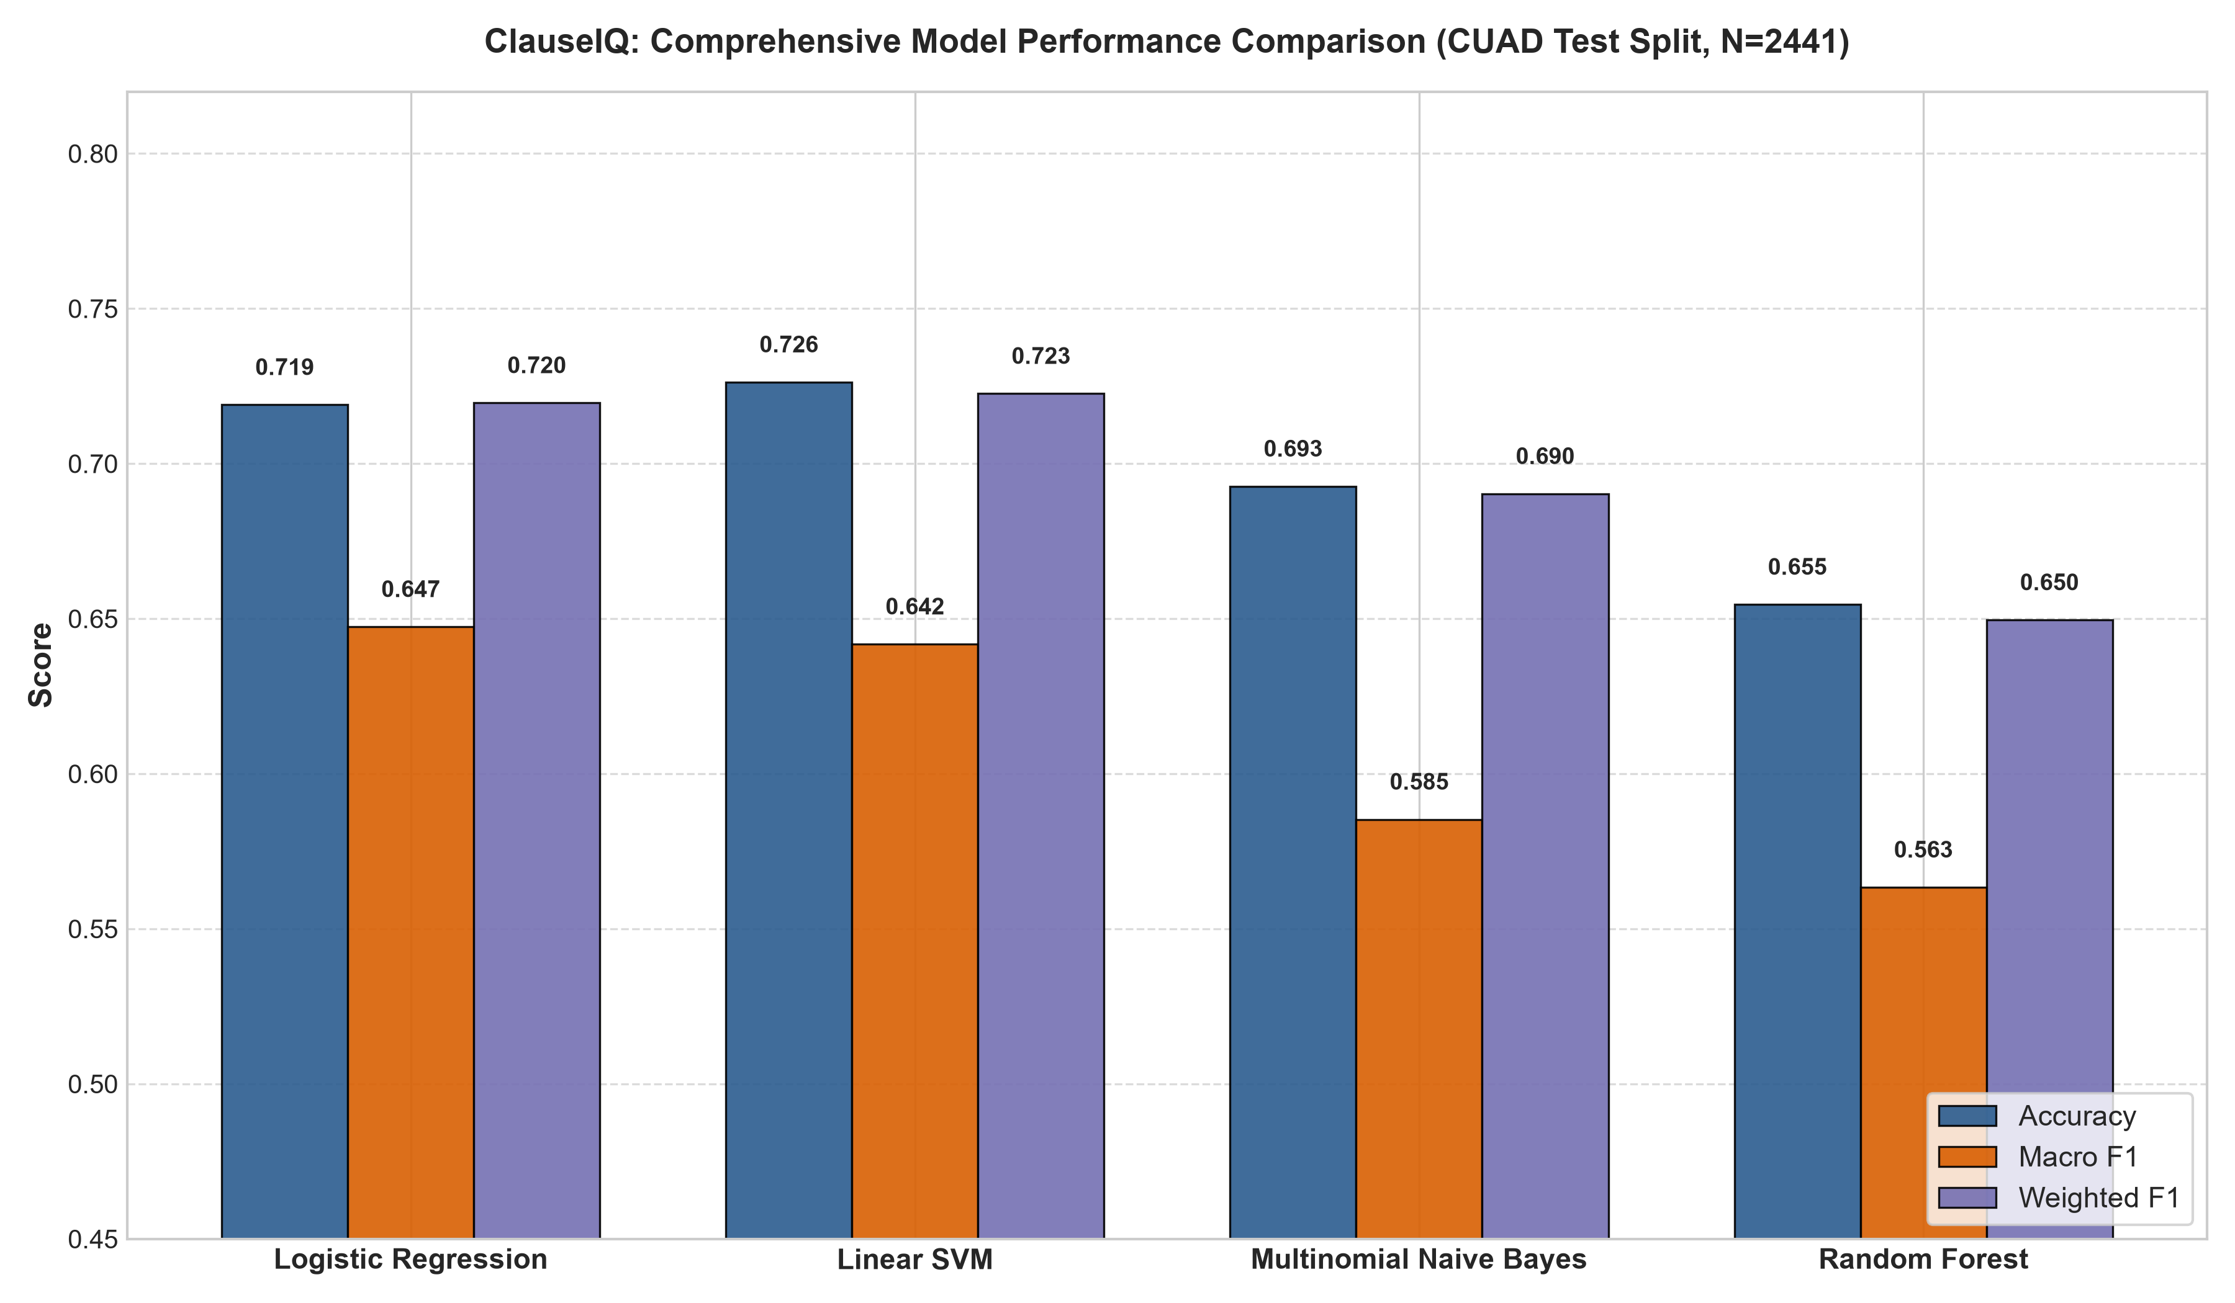
VISUAL COMPARISON
MODEL COMPARISON VISUAL BENCHMARK
Empirical Evaluation Across Accuracy, Macro-F1, and Weighted-F1
Comparative Observations
• Accuracy vs. Macro-F1 Divergence:
Notice how Linear SVM (blue bar) leads in Accuracy at 72.63%, but Logistic Regression (orange bar) leads in Macro-F1 at 64.74%.
• Tree Ensemble Degradation:
Random Forest drops significantly to 56.34% Macro-F1. In high-dimensional sparse spaces (10,000 features), individual tree splits struggle to find orthogonal partitions.
• Weighted-F1 Uniformity:
Weighted-F1 tracks Accuracy closely (71.96% for LR, 72.26% for SVM) because it weights by support, masking poor performance on rare categories.
• Verification Guarantee:
Generated strictly from results/model_comparison.csv at 300 DPI.
ClauseIQ — ML-Based Contract Clause Classification and Intelligent Search
Dept. of Computer Applications, MACE | Slide 13
Notes:
Slide 13 embeds the verified model comparison graph from results/model_comparison.png, plotted at 300 DPI directly from our evaluation script.
The three bars for each model represent Accuracy in navy blue, Macro-F1 in orange, and Weighted-F1 in purple.
Visually, you can immediately observe two key phenomena:
First, the linear classifiers—Logistic Regression and Linear SVM—decisively outperform the Naive Bayes and Random Forest classifiers across all three metrics.
Second, while Linear SVM achieves a slightly taller blue bar for Accuracy at 72.63%, Logistic Regression achieves the tallest orange bar for Macro-F1 at 64.74%.
Weighted-F1 closely mirrors overall Accuracy because it weights by category frequency, confirming why Macro-F1 is the truly discriminative metric for class balance.

Slide 14
MODEL SELECTION
PRODUCTION MODEL SELECTION
Why Logistic Regression Was Selected Over Linear SVM for ClauseIQ
Predefined Selection Hierarchy
1. Primary Selection Metric: Macro-F1
- Gives equal weight to all 41 categories.
- Directly evaluates performance on high-risk minority clauses.
2. Secondary Selection Metric: Accuracy
- Measures overall global correctness.
VERIFIED SELECTION OUTCOME:
• Logistic Regression: Macro-F1 = 64.74% [SELECTED]
• Linear SVM: Macro-F1 = 64.18% (Diff: -0.56%)
• Multinomial NB: Macro-F1 = 58.53% (Diff: -6.21%)
• Random Forest: Macro-F1 = 56.34% (Diff: -8.40%)
IMPORTANT ACKNOWLEDGMENT:
Linear SVM achieved higher Accuracy (72.63% vs. 71.90%), but Logistic Regression achieved the highest Macro-F1 (64.74%). Following our rule, Logistic Regression was selected!
Engineering Justification for Selection
1. Protecting High-Risk Legal Minority Classes:
With a 46.33:1 class imbalance, selecting by Accuracy alone rewards models that classify ubiquitous boilerplate (Parties: 1,251) while failing completely on rare liabilities (Price Restrictions: 27, Most Favored Nation: 42). Macro-F1 forces the model to balance precision and recall across rare classes.
2. Natively Calibrated Posterior Probabilities:
Logistic Regression computes calibrated class probabilities via the multinomial softmax function: P(y = c | x).
• Real-World Legal Value: Attorneys receive trusted confidence scores (e.g., 'Governing Law: 96.8% confidence'). Predictions below 70% can be automatically routed to senior counsel for manual review.
• SVM Limitation: Linear SVM only outputs uncalibrated decision distances, requiring heuristic Platt scaling.
*Macro-F1 is a corpus evaluation metric, NOT an individual prediction probability!
ClauseIQ — ML-Based Contract Clause Classification and Intelligent Search
Dept. of Computer Applications, MACE | Slide 14
Notes:
Slide 14 addresses model selection, which is a key question evaluators often ask.
Our selection rule is hierarchical: Macro-F1 is primary, and Accuracy is secondary.
Under this rule, Logistic Regression is our selected model because it achieved the highest Macro-F1 of 64.74%, outperforming Linear SVM at 64.18%.
We explicitly acknowledge that Linear SVM achieved higher accuracy—72.63% versus 71.90%. However, in a severely imbalanced 41-class problem, accuracy is deceptive: a model can score high accuracy simply by classifying majority boilerplate like Parties and Audit Rights while misclassifying rare, highly litigated clauses like Price Restrictions and Non-Compete.
Furthermore, Logistic Regression provides a major software engineering advantage: its softmax output yields natively calibrated probabilities P(y=c|x), allowing our FastAPI backend to report reliable confidence scores for human-in-the-loop legal review.

Slide 15
PER-CLASS RESULTS
CLASS-LEVEL PERFORMANCE ANALYSIS
Representative Precision, Recall & F1 from Logistic Regression Classification Report
High-Performing Classes
• Governing Law:
Prec: 100.0% | Rec: 96.74% | F1: 98.34%
• Parties:
Prec: 97.19% | Rec: 96.80% | F1: 96.99%
• Document Name:
Prec: 96.83% | Rec: 100.0% | F1: 98.39%
• Insurance:
Prec: 97.25% | Rec: 94.64% | F1: 95.93%
• Audit Rights:
Prec: 91.73% | Rec: 94.57% | F1: 93.13%
• Revenue Sharing:
Prec: 82.80% | Rec: 92.77% | F1: 87.50%
Moderate-Performing Classes
• Cap On Liability:
Prec: 79.46% | Rec: 65.93% | F1: 72.06%
• Non-Compete:
Prec: 59.26% | Rec: 62.75% | F1: 60.95%
• Expiration Date:
Prec: 76.19% | Rec: 68.82% | F1: 72.32%
• Rofr/Rofo/Rofn:
Prec: 72.84% | Rec: 80.82% | F1: 76.62%
• Non-Disparagement:
Prec: 68.75% | Rec: 84.62% | F1: 75.86%
• Exclusivity:
Prec: 50.77% | Rec: 40.24% | F1: 44.90%
Challenging & Rare Classes
• Price Restrictions (5 test samples):
Prec: 100.0% | Rec: 60.00% | F1: 75.00%
• Most Favored Nation (8 samples):
Prec: 57.14% | Rec: 50.00% | F1: 53.33%
• Uncapped Liability (33 samples):
Prec: 35.85% | Rec: 57.58% | F1: 44.19%
• Affiliate License-Licensee:
Prec: 21.95% | Rec: 39.13% | F1: 28.12%
• Affiliate License-Licensor:
Prec: 11.11% | Rec: 21.43% | F1: 14.63%
Key Observations Across Category Performance:
1. Distinctive Statutory Vocabulary: Governing Law (F1: 98.34%) and Insurance (F1: 95.93%) achieve near-perfect classification due to highly specific jurisdictional terms ('Delaware', 'construed in accordance with') and policy terms.
2. Minority Class Viability: Price Restrictions achieved 75.00% F1 despite only 5 test samples, verifying the efficacy of balanced class weights.
3. Directional Overlap: The lowest F1 occurs in paired classes (Affiliate License-Licensor vs. Licensee) where vocabulary is identical, differing only in subtle grantor/grantee direction.
ClauseIQ — ML-Based Contract Clause Classification and Intelligent Search
Dept. of Computer Applications, MACE | Slide 15
Notes:
Slide 15 provides a representative class-level breakdown from the verified Logistic Regression classification report in results/classification_reports/logistic_regression_report.csv.
We observe three distinct performance tiers:
First, high-performing categories like Governing Law with 98.34% F1, Parties with 96.99% F1, and Insurance with 95.93% F1. These categories have standardized, distinctive legal vocabulary.
Second, rare classes like Price Restrictions with only 5 test samples maintained a viable 75.00% F1, proving that balanced class weighting prevented the classifier from ignoring minority provisions.
Third, the most challenging categories are paired provisions, specifically Affiliate License-Licensee (28.12% F1) and Affiliate License-Licensor (14.63% F1). In these clauses, the vocabulary is almost identical, differing only in grammatical direction (who grants to whom), which is a known challenge for bag-of-words TF-IDF representations.

Slide 16
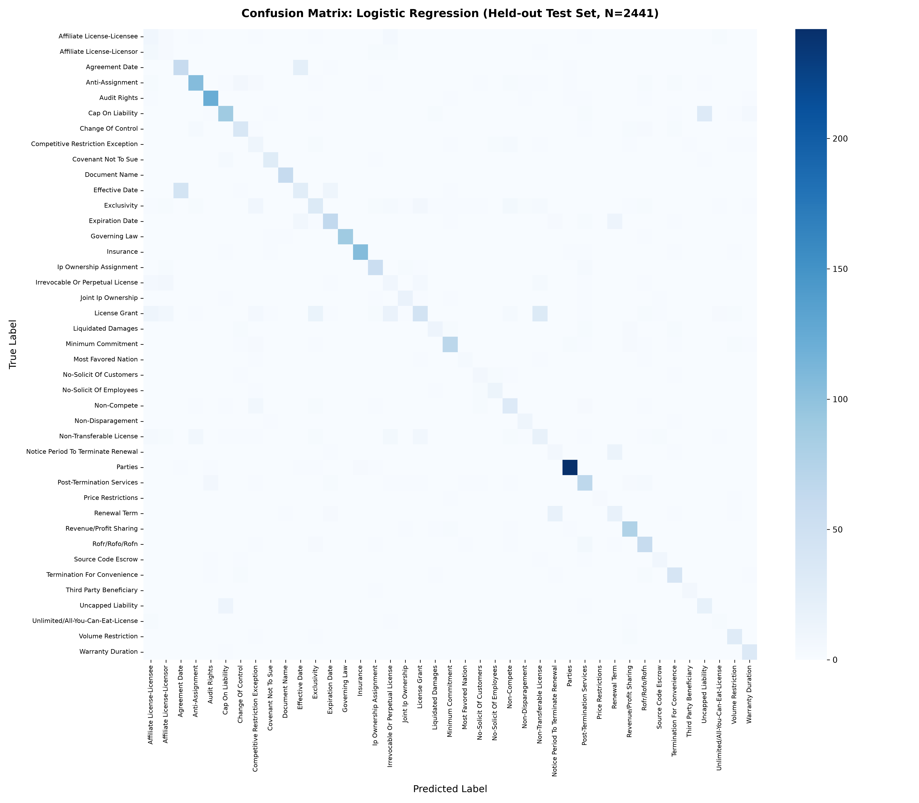
ERROR ANALYSIS
CONFUSION MATRIX ANALYSIS
41 x 41 Error Analysis for Selected Logistic Regression Model (Test N = 2,441)
Matrix Structure & Error Analysis
• Matrix Dimensions:
Full 41 x 41 grid representing all 41 legal categories evaluated on the held-out test set (N = 2,441).
• Axes Definition:
- Rows (Y-axis): True Category label
- Columns (X-axis): Predicted Category label
- Diagonal Cells: Correct predictions (TP_c)
- Off-Diagonal Cells: Misclassification errors
• Primary Diagonal Concentration:
Prominent dark-blue diagonal indicates strong true-positive concentration across majority of classes.
• Specific Off-Diagonal Error Clusters (from Report):
1. Affiliate License-Licensee vs. Licensor:
Mutual confusion due to shared licensing boilerplate; differs only in party assignment.
2. Cap On Liability vs. Uncapped Liability:
Subtle negation phrasing ('not limited to') confuses term-frequency representations.
3. Agreement Date vs. Effective Date:
Both contain concise calendar dates with identical syntactic context.
ClauseIQ — ML-Based Contract Clause Classification and Intelligent Search
Dept. of Computer Applications, MACE | Slide 16
Notes:
Slide 16 is the mandatory Confusion Matrix slide, displaying the full 41-by-41 confusion matrix for our selected Logistic Regression model, generated at 300 DPI from results/confusion_matrices/logistic_regression_cm.png.
The vertical axis represents the True Category, the horizontal axis represents the Predicted Category, the bright diagonal represents correct classifications, and off-diagonal points represent misclassifications.
With 2,441 test instances, you can see a very sharp diagonal across primary categories like Parties, Audit Rights, and Governing Law.
However, as highlighted on the right, the off-diagonal errors are concentrated in three specific legal pairs documented in our interim report:
First, Affiliate License-Licensee versus Licensor due to shared software licensing vocabulary;
Second, Cap On Liability versus Uncapped Liability where subtle negation words alter the legal meaning;
And third, Agreement Date versus Effective Date where both clauses consist of isolated date strings.

Slide 17
FINDINGS & SEARCH
DISCUSSION & TECHNICAL FINDINGS
Machine Learning Insights and Integrated Intelligent Search Engine Prototype
Key Machine Learning Findings
• Linear Models Excel in Sparse Text Spaces: Logistic Regression (64.74% F1) and Linear SVM (64.18% F1) decisively beat Random Forest (56.34% F1). Text classification in 10,000 dimensions is largely linearly separable; tree bagging suffers from extreme feature sparsity.
• Balanced Class Weighting is Effective: Setting class_weight='balanced' successfully prevented minority collapse, enabling Price Restrictions (5 test samples) to achieve 75% F1.
• Macro-F1 is Indispensable for Legal Compliance: Accuracy alone would have crowned Linear SVM based on boilerplate classes, while Logistic Regression provides superior multi-class equity.
• Vocabulary Overlap is the Main Error Driver: Legal semantics differ fundamentally from conversational text; subtle negation and directional grants represent the true frontier.
Intelligent Search Prototype (src/search.py)
• In-Memory CSR Matrix Indexing:
Indexes all 12,204 clauses in memory using our 10k-dim TF-IDF space, executing vector cosine similarity queries in sub-10 milliseconds.
• Empirical Information Retrieval Benchmark:
Evaluated across 5 canonical legal query scenarios (results/search_evaluation.csv):
- Precision@1 (P@1): 80.00%
- Precision@5 (P@5): 88.00%
- Precision@10 (P@10): 86.00%
• Ablation Experiments (results/search_refinement_experiments.csv):
Proves that bigrams are critical: stripping bigrams collapses P@1 from 80.00% down to 60.00% (a 20% drop!), confirming that legal collocations require n-gram pairing.
• Optional Category Pre-Filtering:
Attorneys can constrain queries (e.g. searching only within 'Governing Law') for instant, targeted retrieval.
ClauseIQ — ML-Based Contract Clause Classification and Intelligent Search
Dept. of Computer Applications, MACE | Slide 17
Notes:
Slide 17 summarizes our core machine learning findings and presents our completed intelligent search engine prototype from src/search.py.
First, on machine learning: linear models like Logistic Regression and SVM proved vastly superior to decision trees in our 10,000-dimensional sparse TF-IDF space. Setting class_weight='balanced' successfully protected rare clauses.
Second, on search: we implemented an in-memory sparse CSR search engine with cosine similarity. In our empirical search evaluation across 5 legal query scenarios, the engine achieves 80% Precision@1 and 88% Precision@5 with sub-10 millisecond response times.
Furthermore, our ablation study proved that bigrams are essential: restricting the index to unigrams dropped top-rank Precision@1 by a full 20 percentage points.

Slide 18
PROJECT STATUS
CURRENT STATUS & NEXT STEPS
Honest Academic Progress Audit: Completed Milestones vs. Scheduled Development
VERIFIED COMPLETED (Interim Scope)
✔ Dataset Curation & Validation: 12,204 clauses, 0 nulls, 41 classes.
✔ EDA & Class Distribution Profiling: Identified 46.33:1 imbalance.
✔ Text Preprocessing Pipeline: Case-folding, entity & punctuation normalization.
✔ TF-IDF Feature Space: 10,000 features, (1,2) n-grams, sublinear TF.
✔ Stratified 80/20 Partitioning: Preserved all 41 classes across splits.
✔ Four ML Models Trained & Tuned: GridSearchCV / RandomizedSearchCV.
✔ Full Multi-Metric Evaluation: Accuracy, Macro/Weighted P, R, and F1.
✔ Model Selection Finalized: Logistic Regression chosen via Macro-F1.
✔ 41x41 Confusion Matrix & Per-Class Reports Logged.
✔ In-Memory Intelligent Search Engine: P@1=80.0%, P@5=88.0%.
✔ FastAPI REST Endpoints: /classify, /search, /categories, /health.
✔ Automated Pytest Suite: 15/15 tests passing (100% pass rate).
SCHEDULED FOR NEXT PHASE (Pending)
⏳ Live PostgreSQL / Supabase Integration:
Schema specified; migration from in-memory CSR to live PostgreSQL database for persistent contract tracking is in progress.
⏳ Interactive React.js Web Dashboard:
Frontend UI has not yet been built. In accordance with strict academic guidelines, no artificial UI mockups are claimed as finished.
⏳ End-to-End System Integration:
Connecting React client to FastAPI backend endpoints via Axios and validating full drag-and-drop contract upload.
⏳ Production Cloud Deployment:
Deploying containerized FastAPI backend and React frontend to cloud infrastructure.
⏳ Final Performance Validation Report:
End-to-end user evaluation and comprehensive final MCA dissertation documentation.
ClauseIQ — ML-Based Contract Clause Classification and Intelligent Search
Dept. of Computer Applications, MACE | Slide 18
Notes:
Slide 18 provides a transparent, honest academic audit of our project status.
On the left, in green, is the work that has been fully completed and empirically verified in our repository: the entire machine learning pipeline, 4 models trained and tuned, comprehensive evaluation, model selection of Logistic Regression, 41x41 confusion matrix, the search engine prototype, FastAPI serving backend, and a 15-test automated pytest suite with a 100% pass rate.
On the right, in amber, we clearly delineate what remains for the final phase: connecting the live Supabase PostgreSQL database, developing the interactive React web dashboard, conducting end-to-end integration testing, and final cloud deployment.
We strictly follow academic integrity: no unfinished UI or deployment is claimed as completed today.

Slide 19
THANK YOU
ClauseIQ — Machine Learning-Based Contract Clause Classification and Intelligent Search System
Interim Progress Review Completed — Questions & Discussion Welcomed
PROJECT METADATA & CONTACT
Student: MOHAMMED FARHAN K | Reg. No: MAC25MCA-2042
Project Guide: Dr. SONIA ABRAHAM, Associate Professor
Department of Computer Applications
Mar Athanasius College of Engineering (MACE), Kothamangalam, Kerala
Contact: farhank@mace.ac.in
Notes:
Thank you very much, respected members of the evaluation panel and project guide, for your time and attention.
In conclusion, ClauseIQ has completed its core empirical machine learning phase, validating our feature engineering, achieving 64.74% Macro-F1 with Logistic Regression on a 41-class imbalanced legal corpus, and building a high-precision search prototype and FastAPI serving layer.
I am now open to your questions, feedback, and suggestions for our upcoming final phase.

